Slide 1
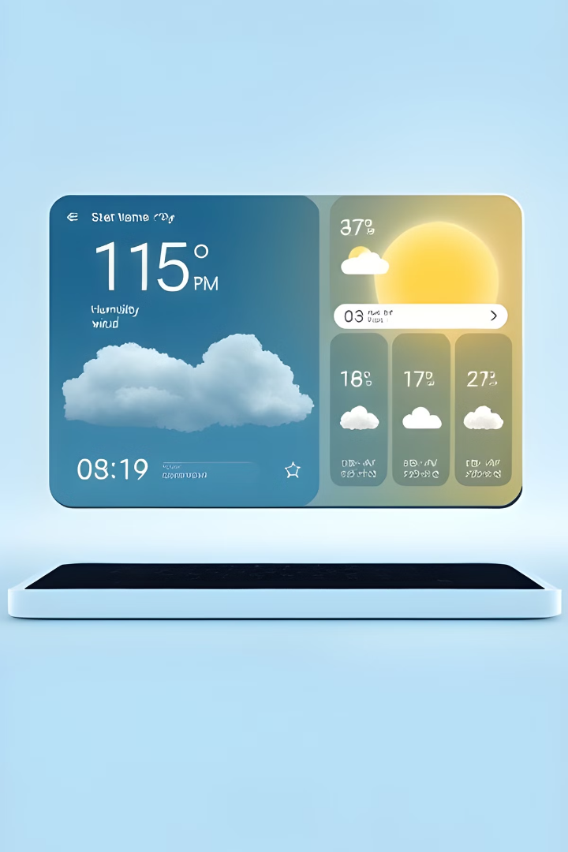

Introducing My Weather Application: Providing Real-Time Information
My app offers a simple and intuitive way to access reliable weather information. It's the perfect tool for planning your day, whether you're a casual user or a professional who relies on accurate weather forecasts.
by Iftekhar Rahman

Slide 2
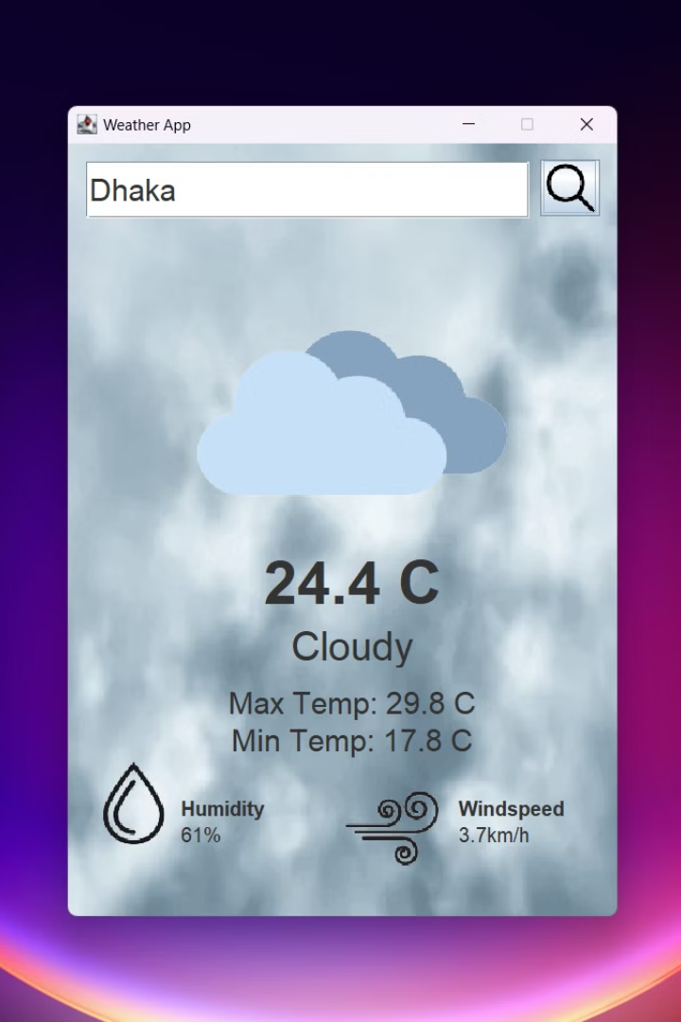
Key Features: Empowering Users
1
Real-Time Data
2
Location Search
Current conditions, temperature, humidity, wind speed, and more
Search for any location worldwide, get personalized forecasts
3
Responsive Design
Dynamically adjusts the interface to match the current weather

Slide 3
Technologies That Power The App
Java Frameworks
Database
JSON.simple, Java Standard Library, Java AWT APIs
OpenMateo Database, JSON and JSONObject for data storage and retrieval

Slide 4

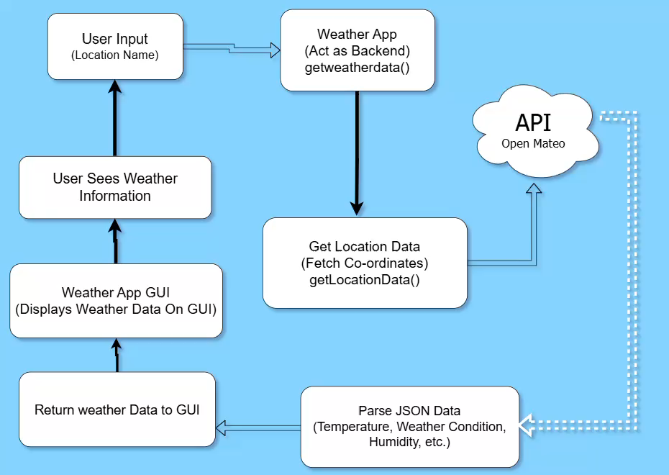
Workflow and Architecture: A Seamless Approach
1
Data Fetching
Retrieving weather data from a reliable weather API
2
Data Processing
Transforming raw data into user-friendly formats
3
UI Rendering
Displaying information on the app, dynamically updated

Slide 5
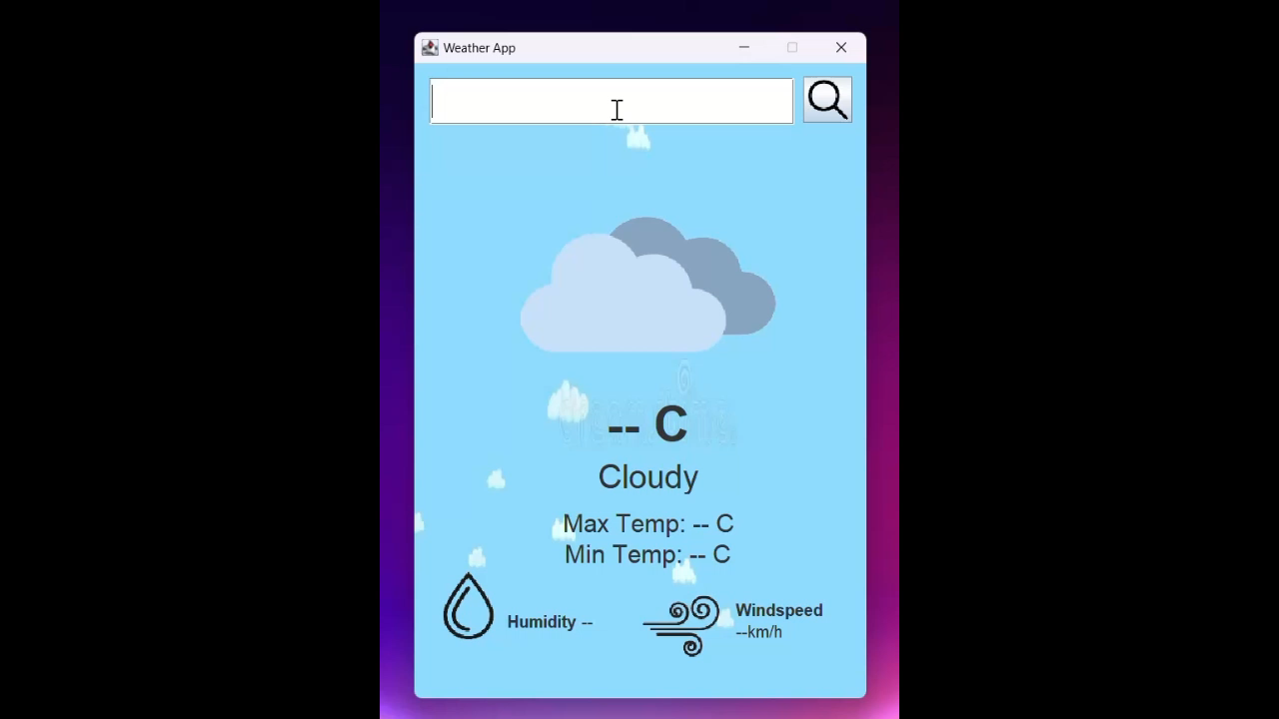
Live Demo: See Our App In Action
Let's see how our weather app functions in real-time, showcasing its intuitive interface and valuable features.

Slide 6

Challenges Faced and Solutions
API Integration
Edge Cases
Ensuring seamless data retrieval from the weather API
Handling unexpected data formats or API responses gracefully
Performance Optimization
Ensuring fast loading times and smooth user experience

Slide 7
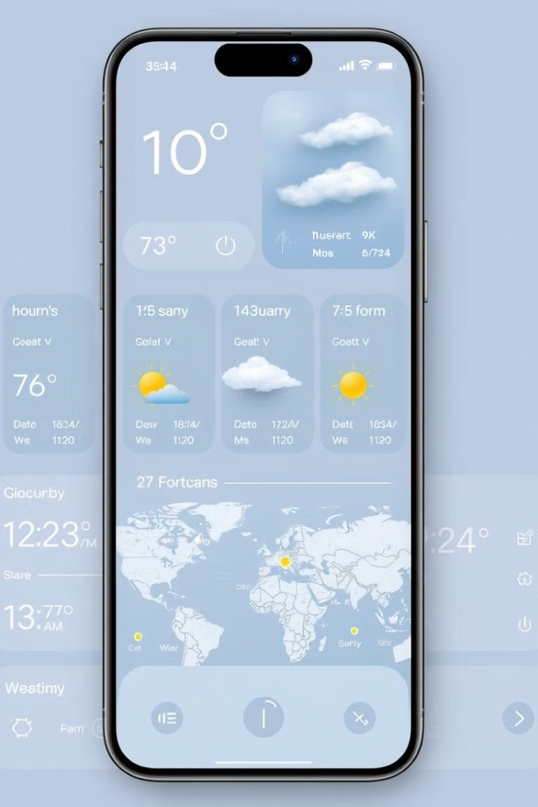



Future Enhancements: Expanding Functionality
Hourly Forecasts
Providing detailed weather predictions for specific hours
Enhanced UI/UX
Improving the visual appeal and user experience
Push Notifications
Alerting users about severe weather events

Slide 8

Conclusion: Empowering Users with Knowledge
Our weather application provides users with the knowledge they need to make informed decisions about their day. We're excited to continue improving our app, adding new features and enhancements to provide an even more powerful and enjoyable experience.

